Slide 1
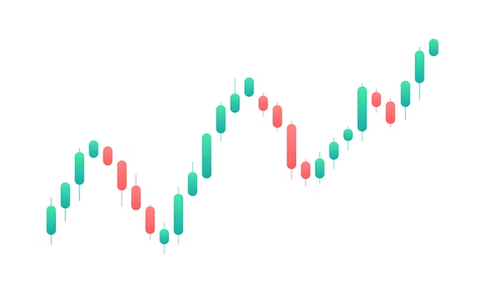
PREDICTION ACCURAY OF CANDLESTICKS
A Graduate Research Report
on
IN NEPALI STOCK MARKET
PRESENTED BY
LAXMAN BHATTARAI Roll No: 24094002
MID-WEST UNIVERSITY SCHOOL OF MANAGEMENT (MUSOM)

Slide 2
Abstract
Evaluate predictive power of candlesticks (Hammer, Inverted Hammer, Hanging Man, Shooting Star)
Bullish/bearish conditions
5 Sectors (Banking, Hydropower, Microfinance, Expensive Stocks, Low-Float Stocks)
Historical NEPSE price data
Algorithmic pattern detection
Comparing Candlestick vs random strategy
Success rate, Return rate
Median vs P-value analysis

Slide 3
Abstract
Hammer: Upto 79% success rate (bullish markets, High-price prediction)
Shooting Star: Upto 84% success rate (bearish markets, Low-price prediction)
Banking (high liquidity): Favored Hammer accuracy
Low-Float Stocks: Amplified Shooting Star reliability.
Closing Prices: Unpredictable (across all sector, candlestick, liquidity and trend)
Efficacy worsens beyond 8 days
Prioritize Hammer in upward trend
Prioritize Shooting Star in downward trend
Avoid Closing prices, Inverted Hammer & Hanging Man

Slide 4
Background
Dow Theory(Explains volume supporting trends, long, medium and short term trends, prices aren’t random, every market variable is counted in price)
Elliott Wave Theory(Is based on dow theory and tells market trends follow repetitive wave trends)
Candlestick origin: 18th century, Japan
Popularized by Steve Nison (1991) in West
Upto 65% success in US market(Bulkowski 2021)
More useful on high retail markets

Slide 5
Background (Candles)
H
H
H
H
C
O
O
C
C
O
O
C
L
L
L
L
Hammer
I. Hammer
Shooting Star
Hanging Man

Slide 6
Background
NEPSE holds 90% retail participation
Dominated by Banking sector (60% of NEPSE capital)
Volatile Hydro and Microfinance sector
Little to none imperical research on candlestick’s efficacy
Retail Trading driven by herd behavior and rumors
Untested technical strategies(oppertunity for technical trading)
No intra-day Tradking (reducing efficacy of candlesticks)

Slide 7
Objectives
Test Candle stick’s accuracy Sectors, Trends, Holding Period & Criteria(high, low or close)
Compare Candlestick vs Random Strategy
An Imperical study in Candlesticks(As there are little to none right now)

Slide 8
Research Questions & Hypotheses
RQ: How effective is the prediction accuracy of candlestick patterns in NEPSE?
H0: There is no relationship between candlestick and the stock movement prediction
H01: There is no relationship between Hammer candlestick and upward stock movement.
H02: There is no relationship between Shooting Star candlestick and downward stock movement.
H03: There is no relationship between Inverted Hammer and upward stock movement.
H04: There is no relationship between Hanging Man candlestick and upward stock movement.

Slide 9
Limitation of the Study
Data limited to last 5 years
No intraday data
Hoding period limited to 8 days
Studies just 4 candlesticks
Lack of backtesting( to validate the results by using them in automated trading simulation in real data from past)

Slide 10
Literature Review
Steve Nison introduced candlesticks to west with the book “ Japanese Candlestick Charting Techniques,1991 ”.
Bulkowski (2002) found that the Hammer pattern had a success rate of 65% in predicting bullish reversals in US where just 12 of 127 candlesticks had significantly better prediction.
(Sehgal & Gupta, 2007)’s study found that patterns like Three White Soldiers and Bullish Engulfing outperformed buy & hold strategies by 8% annually in Fifty 50.
Lo & MacKinlay’s research(2008) showed TA tools being effective in markets where behavioral bias are revelant.

Slide 11
Literature Review
Richard Thaler’s work(2018): Psychology, sentiment > fundamentals for price movements.
Escobari’s research on 2017, Mexico : Predicting efficacy Stable Sectors < Volatile Sectors.
Davies’ research on 2022, Nigeria: Engulfing and Bearish Harami had limited. Reason: low liquidity and high market manipulation
No similar studies in Nepali Market
Ramesh Vaidhya (2018): Candlesticks are the least used techincal analysis tools in Nepal.

Slide 12
Research Gap
Lack of Nepal Focused Emperical Research(most of them are conducted in developed market)
Lack of Sector Specific Research
Lack of study on how low cap and high cap sector interact with Candlesticks
No Random Benchmarking Available
Absence of study on effect of holding period in trading in Nepali Market

Slide 13
Conceptual Framework
Independent Variables
Dependent Variables
Candlestick Pattern
Sector
Market
Return Rate
Holding Period
Success Rate
Market Trend
Significance of Prediction
Moving Average/ Stock Trend
Criteria(High, Low, Close)

Slide 14
Research Design
Secondary data
Quasi-Experimental
75 stocks × 5 sectors × 5 years × 4 Candlestick Patterns
1:1 random strategy matching for each candlestick
Descriptive Analaysis
Inferencial Analaysis

Slide 15
Sample & Population
Population : Full price history of all listed stocks in NEPSE
Sample: 15 Stocks × 5 Sectors × 5 years price history data
Time Period : Mid 2019 to Late 2024
Criteria : High, Low, Close
5 Secotrs : Banking, Hydropower, Microfinance, Expensive Stocks & Low Floating, Low Cap stocks

Slide 16
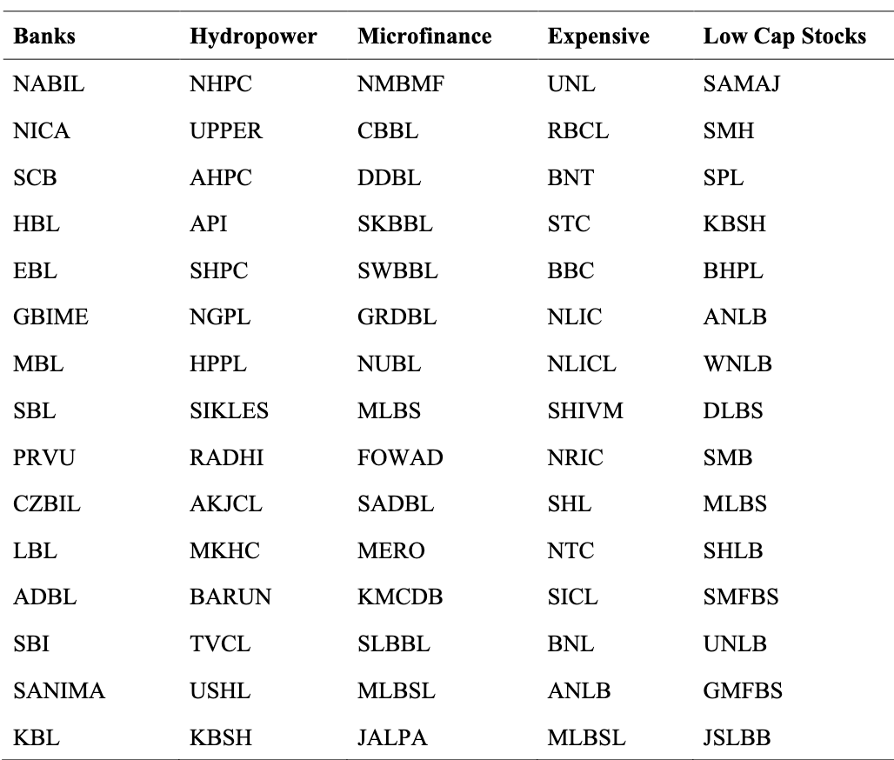
Sample Stocks

Slide 17
Data Collection Process
Create List of Sectors
Random 15 Stocks in each Sector
Download Price History from NepseAlpha
Cleanup and Tansform data to simplest form
Compute Candle patterns
Select same amount of random points in each stock

Slide 18
Methods of Analysis
Data : Time series of price history and candle patterns
Tools: scipy, pandas, plotlyx
Significance Test : p-value
Criteria : High, Low, Close
5 Secotrs : Banking, Hydropower, Microfinance, Expensive Stocks & Low Floating, Low Cap stocks

Slide 19
Data Analysis Process
Calcualte Moving Average of High, Low and Close for past 2,4 and 8 days for candles and random picks
Compare High, Low and Close of day of concern with MAs of past to find short-trend
Compare High, Low and Close of day of concern with MAs of future to find stock movment
Calcualte return rate by comparing a days criteria with MA of Same criteria in various holding periods
Compare the return rate of candle’s day vs random day for descriptive analysis
Organize the return rates based on holding period, short-trend, long trend, sector and criteria as descriptive analysis
Discard the combination of critera, sector, holding period and trend when the return rate of candle’s date is lower than random selection at same combination of variables
Compute Chi-square test for p-value between return rates of candle with respect to return rate of random pick at the same set of combination of variables
Test the stastical significance, check the validy of hypothesis and derive conclusion

Slide 20
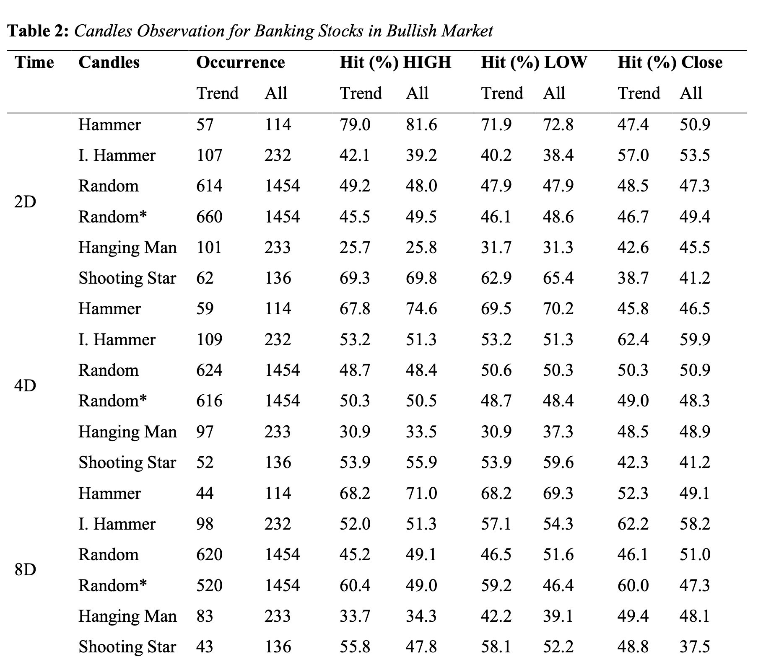
Descriptive Analysis

Slide 21
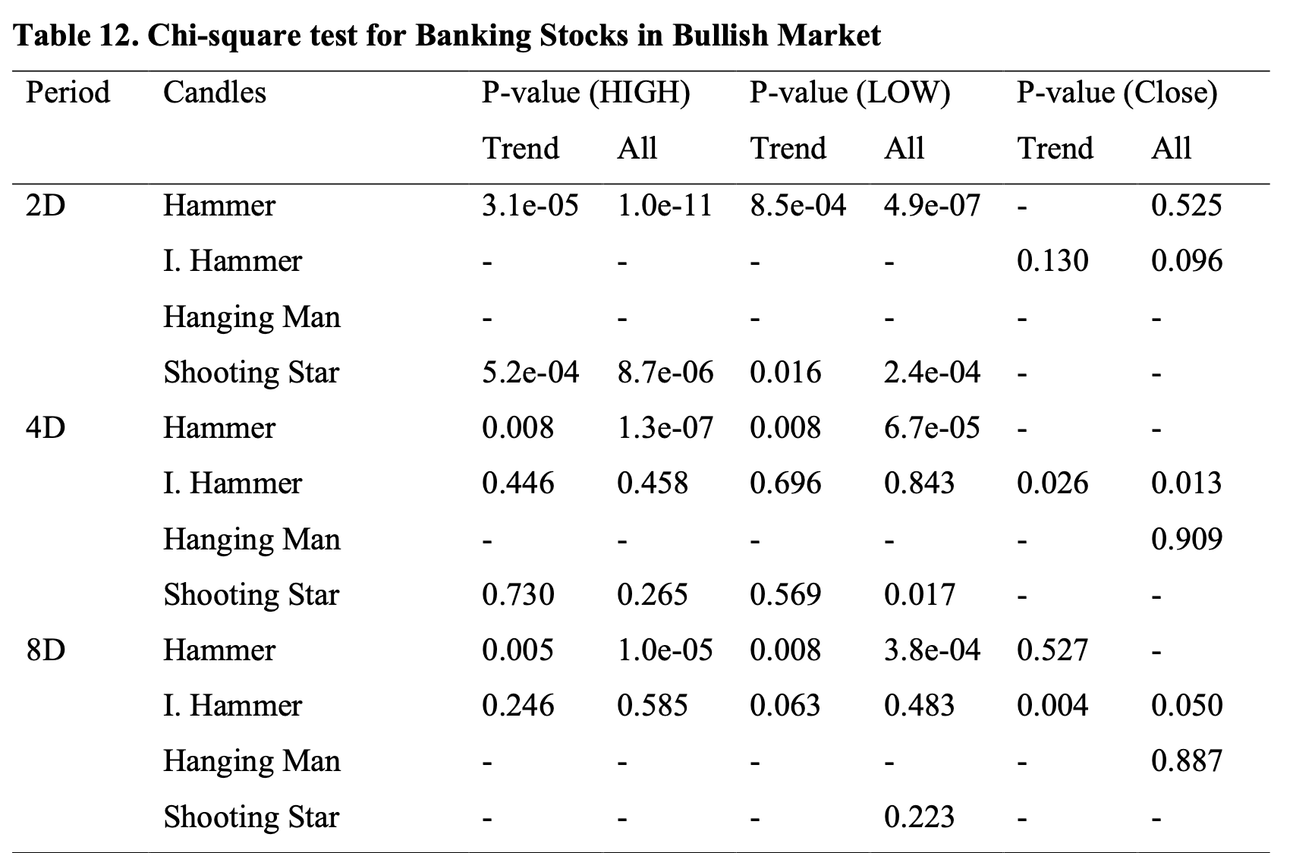
Inferencial Analysis

Slide 22
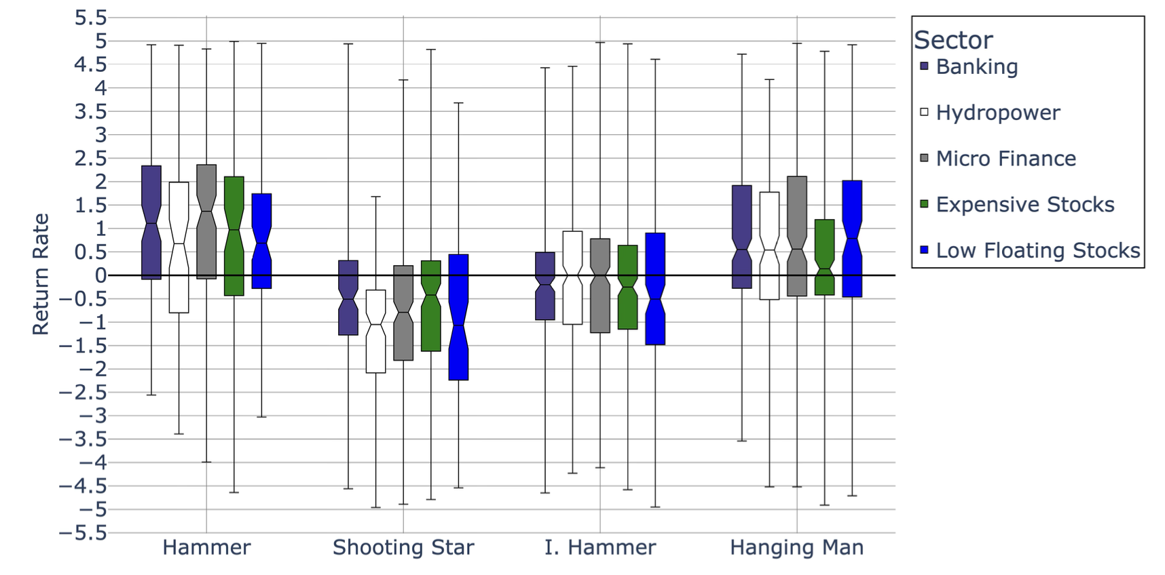
Return Distribution (L/H)

Slide 23
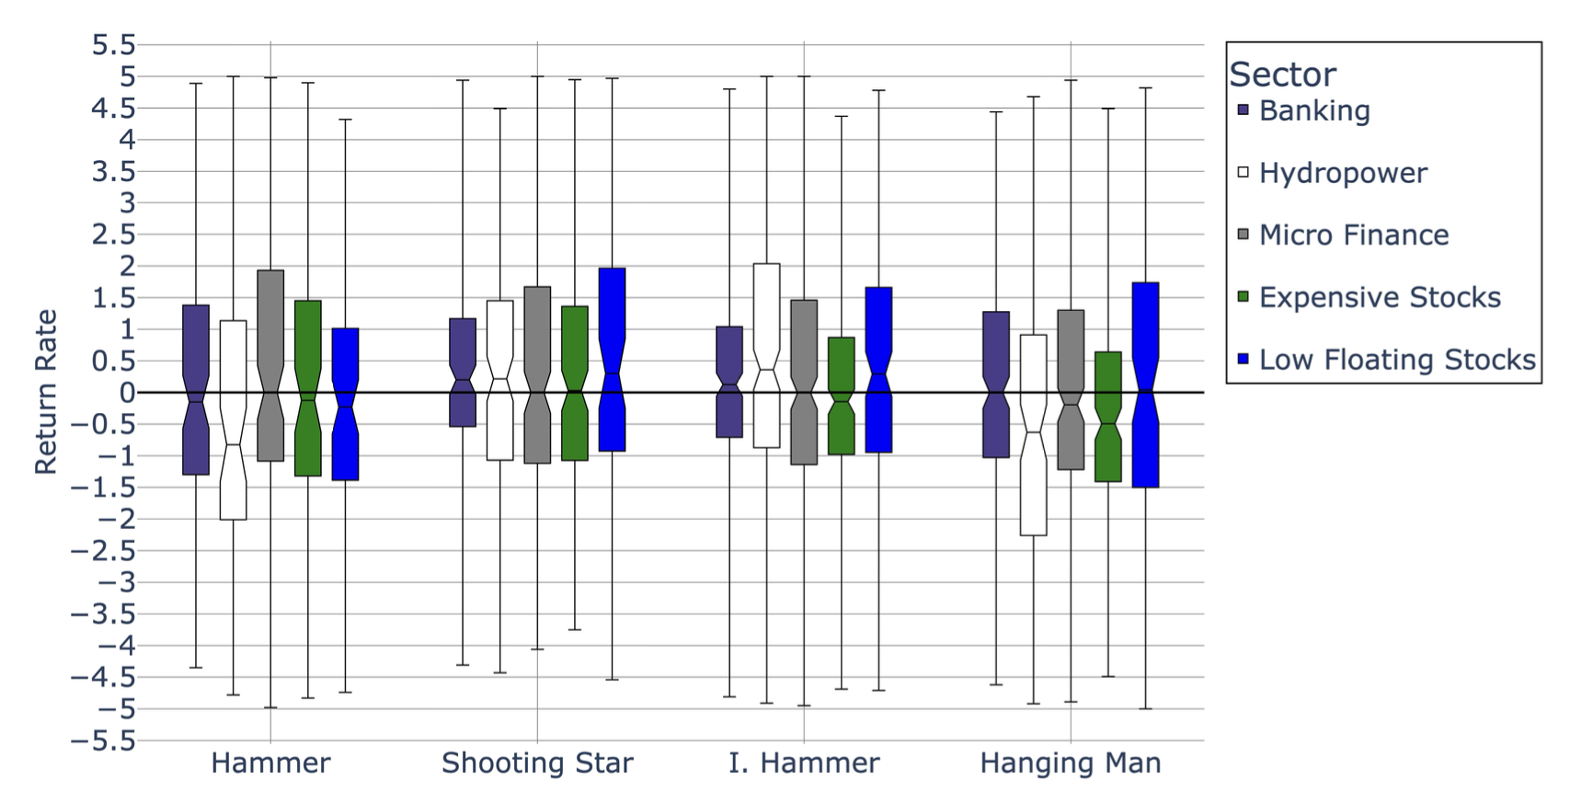
Return Distribution (Close)

Slide 24
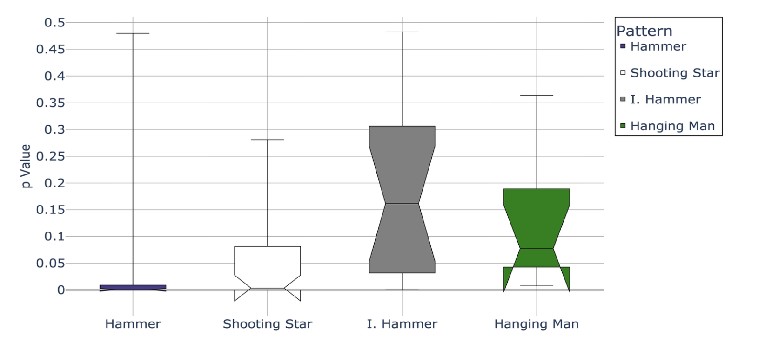
P-value Distribution

Slide 25
Test of Hypothesis
Reject H₀1 for Hammer for High and Close criteria but accept H₀1 for Close Criteria
Reject H₀1 for Hammer for High and Close criteria but accept H₀1 for Close Criteria
Accept H₀3 for Inverted Hammer (H₀3) & Hanging Man (H₀4)

Slide 26
Key Findings (Hammer)
Outperformed random on Highs & Lows by 15-30%
Prediction for CLOSE comparable with random selection
Better at bullish market(10-15%) and short holding period
Predicts “High” better than “Low”
Median return rate was 1 to 1.5%
Success rate ~8% better when following trend

Slide 27
Key Findings (Shooting Star)
Outperformed random on Highs & Lows upto 31%
Prediction for CLOSE comparable with random selection
(P-Value) Hammer <(P-value) Median < 0.001.
Better on bearish market(~12%) and volatile stocks.
Predicts “Low” better than “High”
Succss Rate 5-15% better when following trend

Slide 28
Key Findings (I. Hammer & H. Man)
Both performed poorly
Hanging Man effective on Close Criteria once in a bluemoon
Stastistically insignificant success rates

Slide 29
Conclusions
Hammer and Shooting Star are statistically significant at predicting High and Low but not at Close Criteria
Hammer: Most reliable, delivering consistent results in both bullish and bearish
Shooting Star : Suitable for bearish markets, Low criteria.
Shooting Star's performance wanes in bullish conditions
Inverted Hammer and Hanging Man show almost no value

Slide 30
Conclusions
Hammer and Shooting Star's efficacy goes down on 8-day periods, usable just for short-term trading
Low-floating stocks exhibit higher volatility, amplifying Shooting Star's Low prediction accuracy
No pattern predicts Close prices reliably
Findings challenge the universal applicability of candlestick strategies but validate targeted uses.

Slide 31
Recommendations(Retail Investors)
Prioritize Hammer patterns for 2–4 day High predictions in Banking/Hydropower sectors (79% accuracy)
Utilize Shooting Star patterns for Low predictions in bearish markets (≥75% accuracy in 6 sectors)
Avoid using candlestick patterns for Close price predictions due to underperformance.

Slide 32
Recommendations(Academics)
Investigate the unpredictability of Close prices
Explore integrating machine learning with Hammer and Shooting Star patterns for automated trading
Conduct backtesting based on the findings of this research

Slide 33
Recommendations(Policymakers)
Mandate risk disclosures specific to candle patterns on trading and stock information platforms
Fund education initiatives on statistically validated trading strategies

Slide 34
References
Bulkowski, T. (2021). Encyclopedia of Chart Patterns (3rd ed.)
Escobari, D., Garcia, S., & Mellado, C. (2017). Identifying bubbles in Latin American equity markets: Phillips-Perron-based tests and linkages. Emerging Markets Review, 33, 90–101. https://doi.org/10.1016/j.ememar.2017.09.001
Nepal Rastra Bank. (2023). NEPSE Annual Report 2022-2023 (p. 228) [Annual].
Nison, S. (1991). Japanese candlestick charting techniques: A contemporary guide to the ancient investment techniques of the Far East. New York Institute of Finance.
Park, C., & Irwin, S. H. (2007). WHAT DO WE KNOW ABOUT THE PROFITABILITY OF TECHNICAL ANALYSIS? Journal of Economic
Poudel, A., Bhusal, S., & Datt Pathak, D. (2024). Behaviour Bias and Investment Decision in Nepalese Investors. International Journal of Business and Management, 19(2), 85. https://doi.org/10.5539/ijbm.v19n2p85

Slide 35
References
Prado, H. A. D., Ferneda, E., Morais, L. C. R., Luiz, A. J. B., & Matsura, E. (2013). On theEffectiveness of Candlestick Chart Analysis for the Brazilian Stock Market. Procedia Computer Science, 22, 1136–1145. https://doi.org/10.1016/j.procs.2013.09.200
Sehgal, S., & Gupta, M. (2007). Tests of Technical Analysis in India. Vision: The Journal of Business Perspective, 11(3), 11–23. https://doi.org/10.1177/097226290701100303
Shivaansh Tripathi. (2021). DOW THEORY. Unpublished. https://doi.org/10.13140/RG.2.2.32348.31363

Slide 36
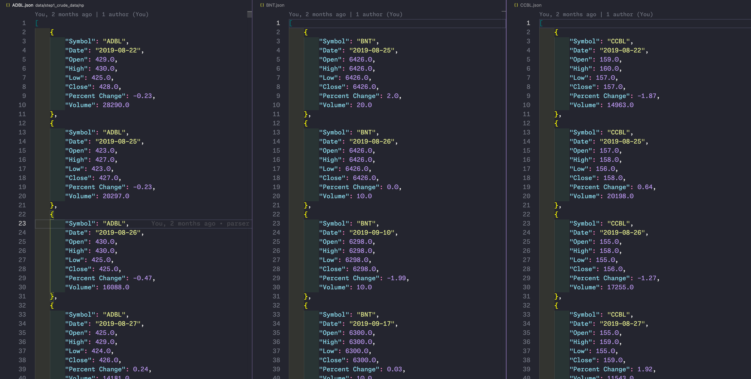
Raw Data

Slide 37
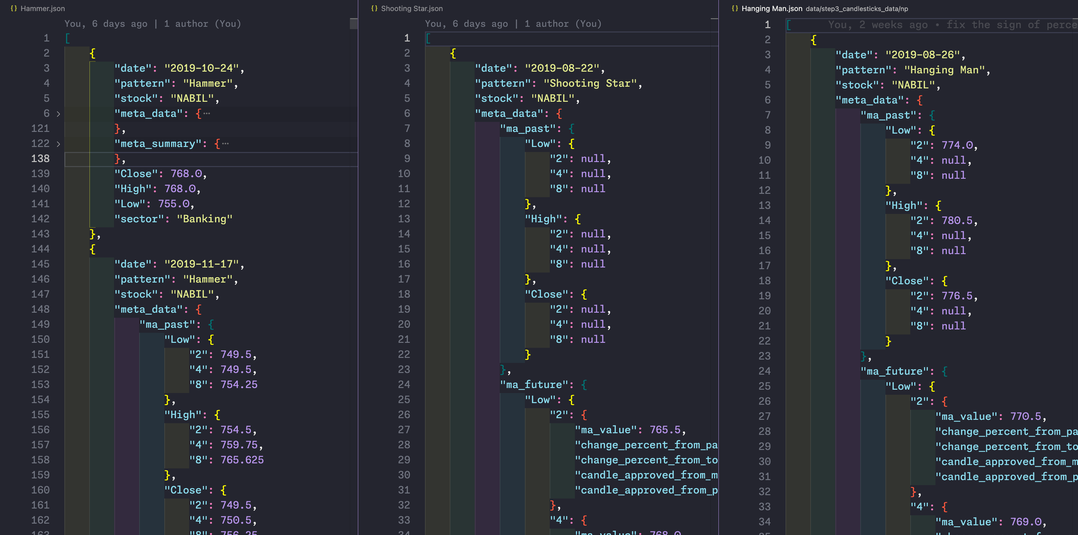
Candle’s Data

Slide 38
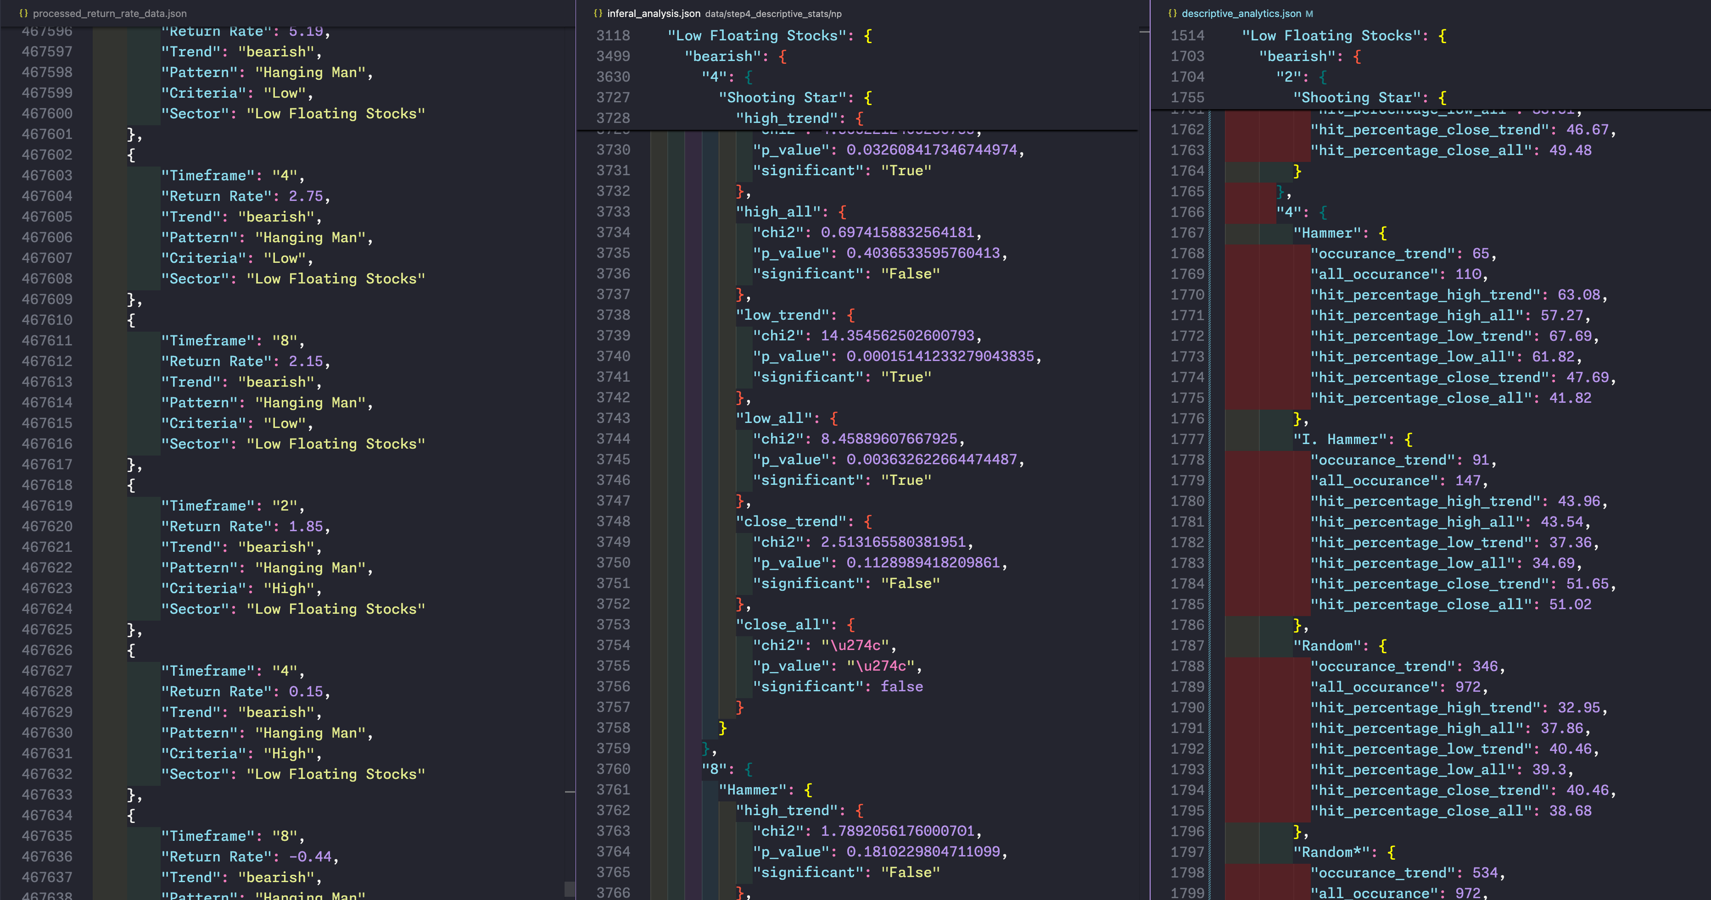
Data Under Analysis

Slide 39
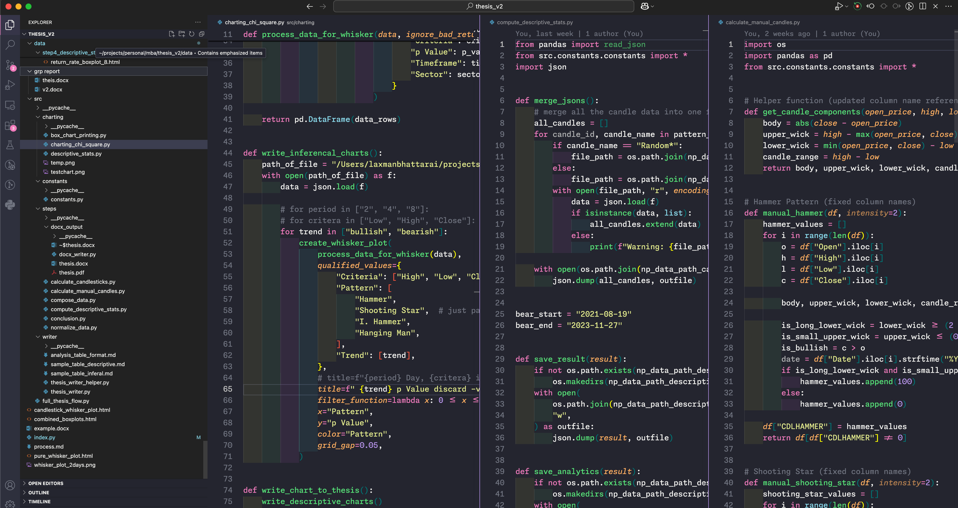
Code Structure

Slide 40
Questions ❓

Slide 41
Thank You
🙏

